Slide 1

Volcanic Skydiving Web Application Project Brochure
By Jonathan Cisneros

Slide 2
Overview
Thank you for taking the time to check out my Volcanic Skydiving Web Application. The purpose for this application is to allow people to experience something new. We try to appeal to those who like adventure and at the same time, like to skydive. In this case, we chose skydiving over volcanos as our main selling point because there aren’t many vendors out there that provide those services. Also, we make sure that volcano’s aren’t about to erupt anytime soon so it’s a safe experience for everyone! The web design is meant to attract users into browsing our beautiful volcano skydiving destinations, while giving admin users the ability to add, delete, update volcano destinations (Not implemented). Future updates would include implementing member access to select a volcano and book a tour and implement admin privileges. Again thank you for your interest in my application and I hope that this will appeal to anyone interested.
Jonathan, Volcanic Skydiving Web Application Owner
Contact Information: jcisneros4@uh.edu

Slide 3
Why Volcanic Skydiving?
New experience
Breathtaking volcano views
We provide state of the art equipment
Safe and Affordable

Slide 4
Why Volcanic Skydiving? (Cont.)
We try to recreate unique experiences that no one has ever tried until now.
If you love volcanos and skydiving, this is perfect for you!
Experience the thrill of a lifetime while witnessing breathtaking views of the worlds famous volcanos
We provide the flight and equipment (excluding hotel, travel, and food prices)
Learn about the history of some of the worlds oldest volcanos
Interact with surroundings upon landing

Slide 5
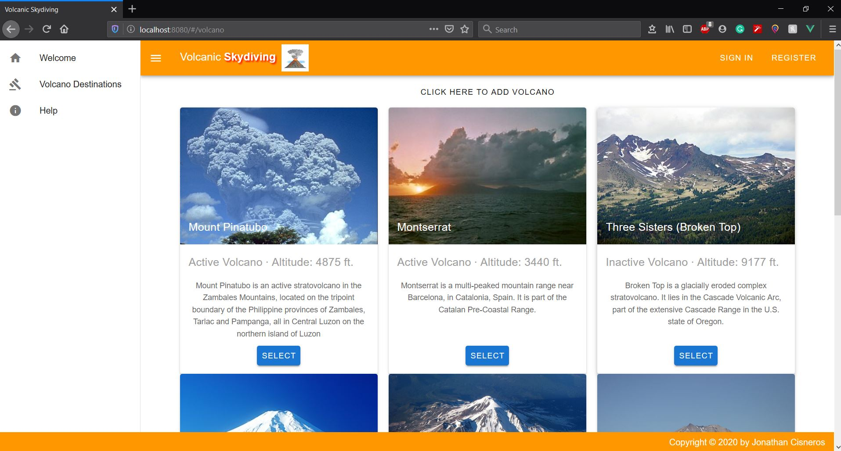
Interactive and beautiful web design provided by Vuetify

Slide 6
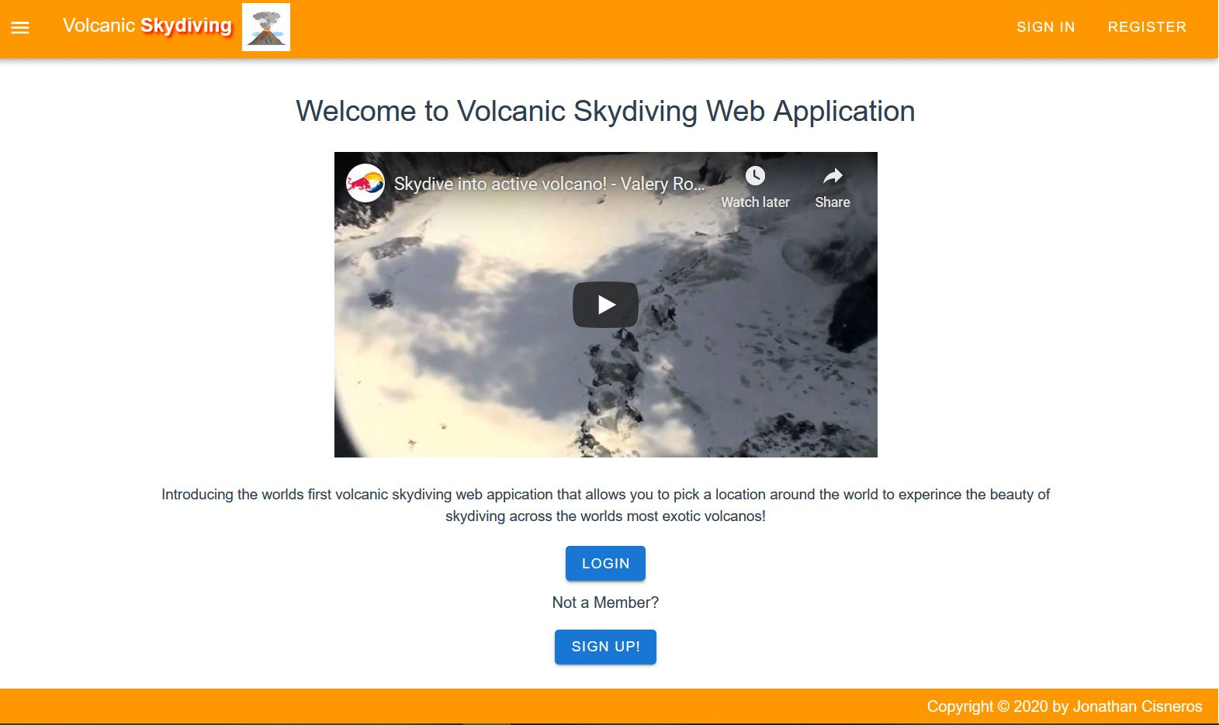
Welcome Page with embedded YouTube link to intrigue user audience

Slide 7
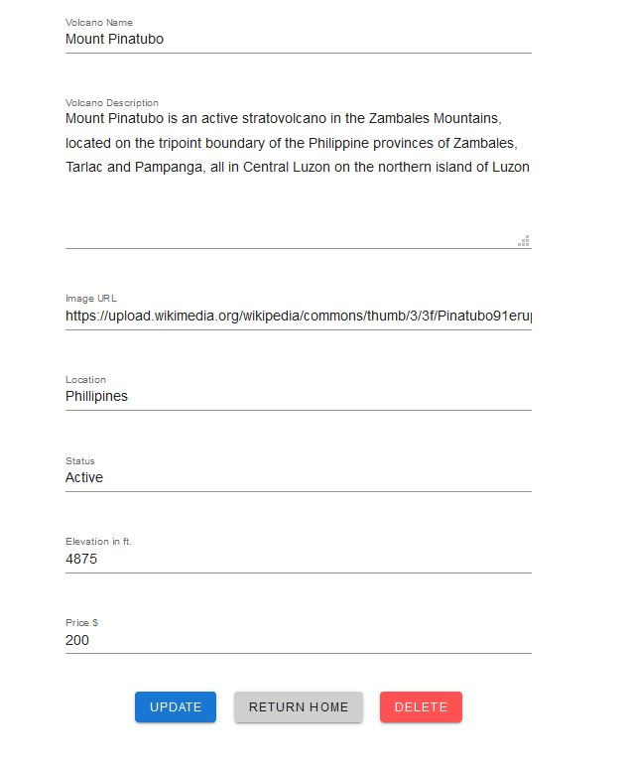
Modify or delete Volcano Information with form validation

Slide 8
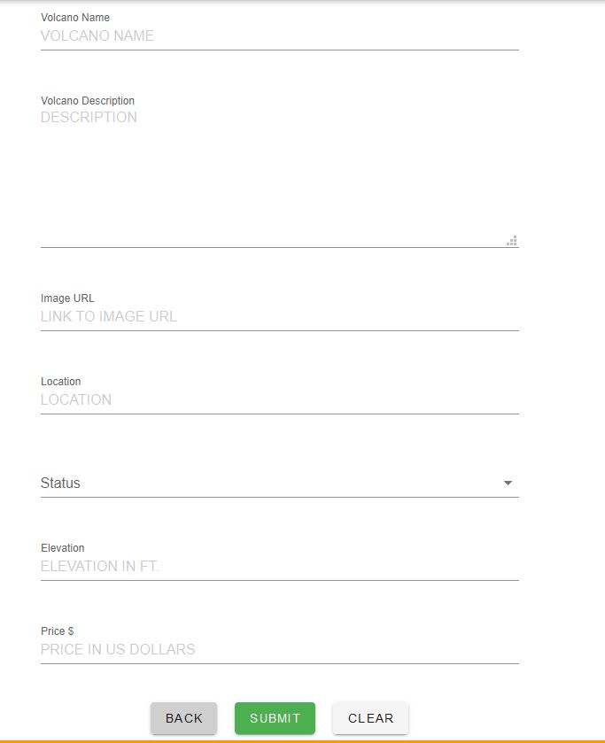
Add a volcano with interactive submission form with form validations

Slide 9
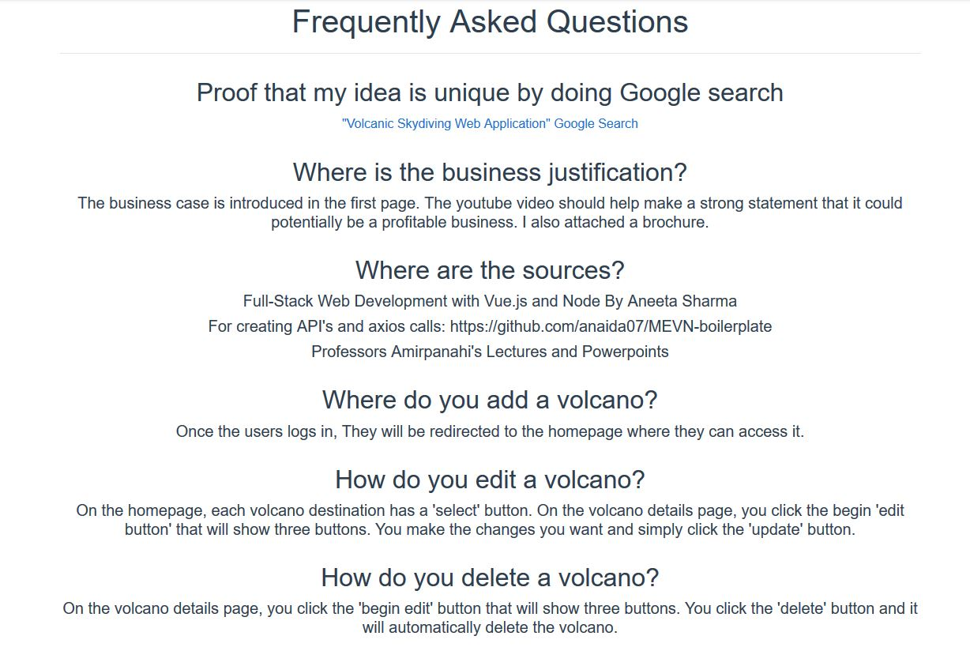
All questions answered with interactive Help page

